Slide 1
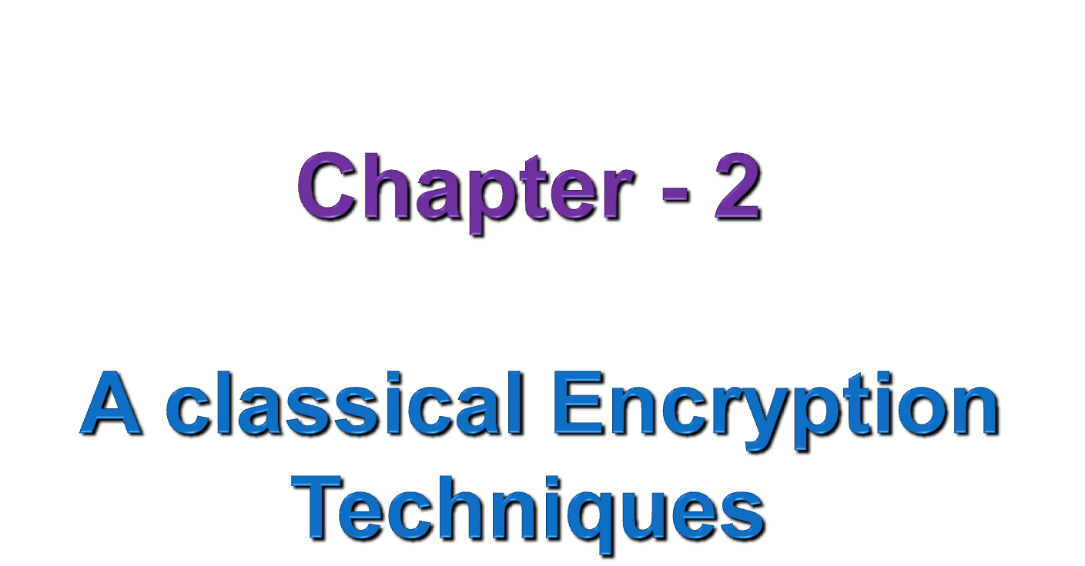
Notes:
SCA3103 - Introduction to Multimedia
Semester 2 - 02/03
Lecture 1

Slide 2
Outline
Introduction
Symmetric Cipher Model
Symmetric Cipher Attacks
Substitution techniques
Transposition techniques
Rotor Machine
Steganography

Slide 3
1. Introduction
Human beings from ages had inherent of two needs
    (a) To communicate and share information
    (b) To communicate selectively
These needs gave rise to art of coding message in such a way that only intended people could have access to the information.
And unauthorized people couldn’t extract any information even if the scrambled messages fell in their hand.
The art and science of concealing(hiding) messages to introduce secrecy in information security is recognized as Cryptography
Cryptography was coined by combining two Greek words,
‘krypto’ = crypto - hide/secret
‘graphene’ = graphy - writing

Slide 4
Cont . . .
Cryptographic System/Cipher - also called cryptosystem is refers to various schemes used for data encryption and decryption.
Cryptology – The study of cryptosystem/cipher
Field of both Cryptography and Cryptanalysis
Cryptography – making cryptosystem
    The art and science of making a cryptosystem that is capable of providing information security.
    Deal with the actual securing of digital data
    Refers to design of mechanisms based on mathematical algorithms

Slide 5
Cont . . .
Cryptology
Cryptography
Cryptanalysis
(Symmetric)-key
(Asymmetric ) -key

Slide 6
Components of Cryptosystem
Plaintext:
  Data to be protected during transmission
  Original intelligible message/data that is fed into the algorithm as input.
Encryption algorithms:
  Mathematical process that produces cipher text for any given plaintext and encryption key.
  Input = plaintext + Secret key , Output = Cipher text
  Perform various transformation/substitutions on the plaintext to transform plaintext to cipher text.
Secret Key/Encryption key:
  Information used in cipher known only to sender/receiver
  INPUT -----> Encryption algorithm

Slide 7
Cont . . .
Cipher text:
  The Scrambled/coded version of message/plaintext produced as output.
  It depends on plaintext and secret key, for given message two different keys will produce two different cipher text.
Encipher (Encryption):- Converting plaintext to cipher text
Decipher (Decryption):- Recovering plaintext from cipher text
Decryption algorithms:
  Transform cipher text to plain text
  Mathematical process, that produces a unique plaintext for a given cipher text and decryption key.
Decryption key: value known by receiver and related to encryption key.

Slide 8
Cont . . .
Type of Cryptographic System/Cipher
(1) The type of operations used for transforming plaintext to cipher text.
  Substitution: in which each element in the plaintext (bit, letter, group of bits or letters) is mapped into another element, and
  Transposition: in which elements in the plaintext are rearranged.
(2) The number of keys used
  If both receiver and sender use the same key, the system is referred to as Symmetric/single-key/secret-key. But If the receiver and sender use different keys, the system is referred to as Asymmetric, two-key/public-key encryption.
(3) The way in which the plaintext is processed.
  Block cipher: processes the input one block of elements at a time, producing an output block for each input block.
  Stream cipher: processes the input elements continuously, producing output one element at a time, as it goes along.

Slide 9
Cont . . .
Security service of Cryptography
Confidentiality:- Keep information privacy or secrecy
    Achieved by physical securing or by use of mathematical algorithms
Data integrity:- Identifying any alteration of data and
    Confirm whether data is intact or not, since it was last created, transmitted, or stored by authorized person
    Cannot prevent alteration of data, only provides means of detection
Authentication:- Provides the identification of the originator
    Confirms to receiver, data received has been sent only by verified sender
    It has two variants; Message authentication and Entity authentication
Non repudiation
    Assure that the original creator of data cannot deny the creation or transmission of the said data to a recipient or third party

Slide 10
2. Symmetric Cipher Mode
Also referred to as conventional encryption or single-key encryption.
The only type of encryption in use prior to the development of modern encryption (1970’s).
Requirements for secure use of conventional encryption
(1) Strong encryption algorithm.
  The opponent should be unable to decrypt cipher text or discover the key even if he/she is in possession of a number of cipher texts together with the plaintext that produced each cipher text.
(2) Exchange of secret key securely
  Sender and receiver must have obtained copies of the secret key in a secure fashion and must keep the key secure.

Slide 11

Cont . . .
Key management
  (1) Using secret channel (2) Encrypt the key
  (3) Third trusted party (4) Sender and Receiver generate key
Fig 2.1: Simplified Model of Symmetric Encryption

Slide 12
Cont . . .
Features of Symmetric encryption
Participants needs to share a common key prior to exchange of information
Keys are recommended to be changed on regular bases to prevent attack.
Only secret key is kept secure and no need to keep the algorithms secret,
    It is impractical to decrypt message on the basis of cipher text plus knowledge of encryption/decryption algorithms.
    This allows manufacturers to developed low-cost chip implementations of data encryption algorithms.
    Result in widespread uses
Faster encryption-decryption process as a result of smaller length of key.
In group of n people, to enable two party communication b/n any two persons , n*(n - 1)/2 number of keys are required for the group.
Problem:- maintaining the secrecy of the key and Trust issues

Slide 13
Cont . . .
Example: Assume sender produces a message in plaintext, X = [x₁, x₂, . . . . x_{m}]. The M elements of X are letters in some finite alphabet (Traditionally consisted of 26 capital letters and Nowadays consist binary alphabet [0,1]).
For encryption, a key of the form K = [k₁, k₂, . . . . k_{j}] is generated and provided to destination by means of some secure channel or a third party.
With the message X and the encryption key k as input, the encryption algorithm forms the cipher text and We can write this as
Y = E(K, X)
Notation indicates that Y is produced by using encryption algorithm E as a function of plaintext, with specific function determined by the value of the key
Intended receiver, in possession of the key, is able to invert transformation:
X = D(K, Y)
An opponent, observing Y but not having access to K or Y, may attempt to recover K or Y or both K and Y.

Slide 14
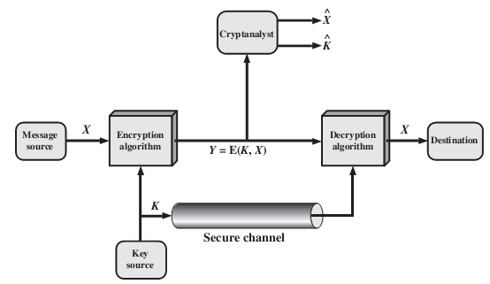
Cont . . .
It is assumed that the opponent knows the encryption (E) and decryption (D) algorithms and the opponent is interested in:
    Only the particular message, then the focus of the effort is to recover X by generating a plaintext estimate
    However, if being able to read future messages as well, an attempt is made to recover K by generating an estimate .
Fig 2.2: Model of Symmetric Cryptosystem

Slide 15
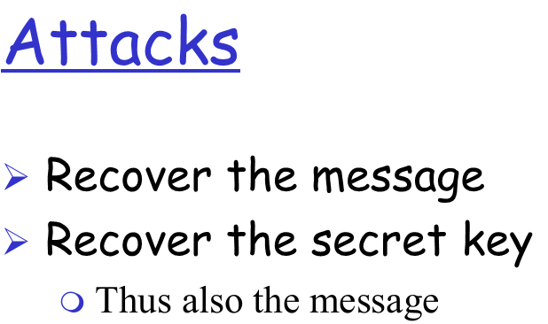
3. Symmetric Cipher Attacks
Objective of attacking an encryption system is to recover the key in use rather than simply to recover the plaintext of a single ciphertext.
Conventional encryption Attack approaches
Cryptanalysis:
  Rely on the nature of the algorithm plus perhaps some knowledge of the general characteristics of the plaintext or even some sample plaintext–ciphertext pairs.
  Exploits the characteristics of the algorithm to attempt to deduce a specific plaintext or to deduce the key being used.
  There are various kind of cryptanalytic attacks based on the amount of information known to the cryptanalyst.
        - Ciphertext only - Known plaintext
        - Chosen plaintext - Chosen ciphertext
        - Chosen text

Slide 16
Cont . . .
Ciphertext only
    Only ciphertext and encryption algorithm (not always).
    Opponent must have some general idea of the type of plaintext such as English or French text, an EXE file, a Java source listing etc.
    Opponents use statistical tests or brute force attack
    Easiest to defend against
Known plaintext
    Information known by the opponent are:
        Plaintext and encryption algorithm
        One or more plaintext-ciphertext pairs.
    Analyst may be able to deduce the secret key on the basis of the way in which known plaintext is transformed.
Notes:
SCA3103 - Introduction to Multimedia
Semester 2 - 02/03
Lecture 1

Slide 17
Cont . . .
Chosen plaintext
    What known by opponents are ciphertext, encryption algorithm, and plaintext message chosen by cryptanalysts, together with its corresponding ciphertext generated with the secret key.
    E.g., if an entire accounting file is being transmitted, opponent may know the placement of certain key words in the header of the file.
Chosen ciphertext
    What known by opponents are ciphertext, encryption algorithm, and ciphertext chosen by cryptanalysts, together with its corresponding decrypted plaintext generated with the secret key.
Chosen text
    Use the combination of both chosen plaintext and chosen ciphertext
    Less commonly employed as cryptanalytic techniques

Slide 18
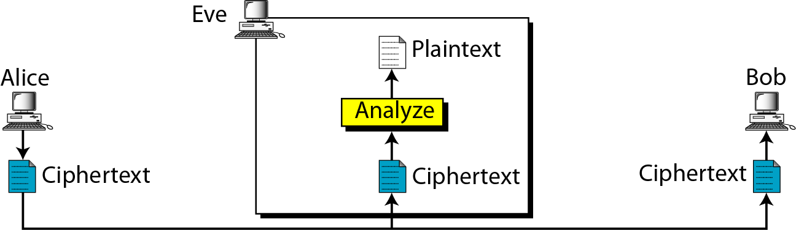
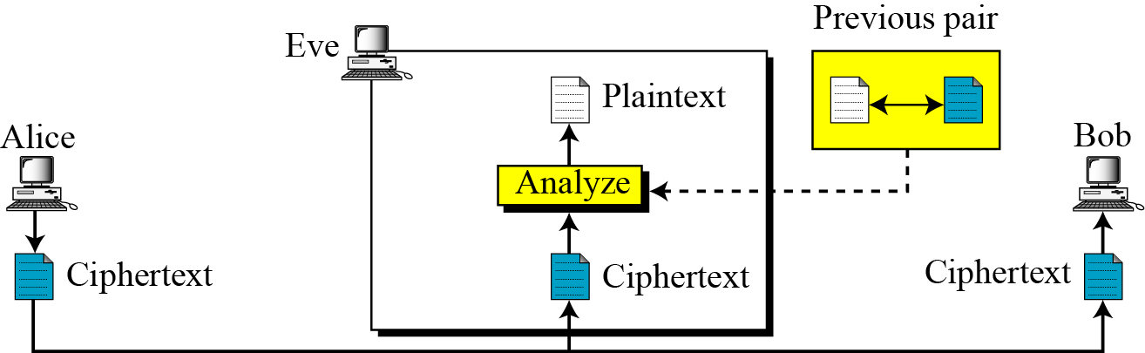
Ciphertext-Only Attack
Known-Plaintext Attack

Slide 19
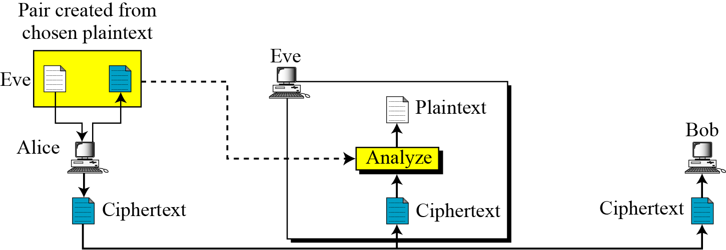
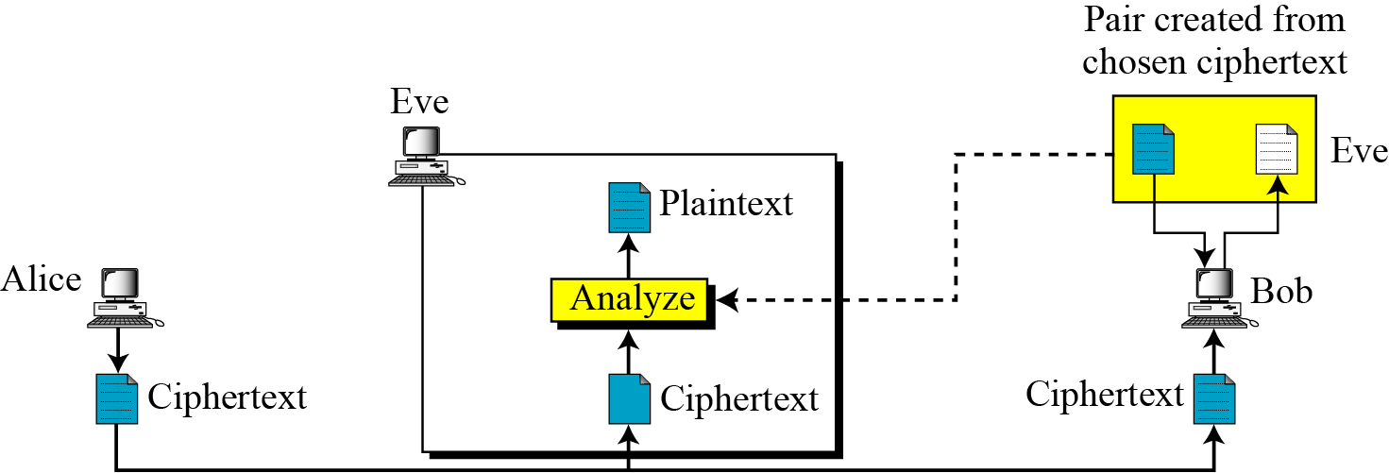
Chosen plaintext Attack
Chosen Ciphertext Attack

Slide 20

Cont . . .
DES – 56 bits key size
AES – 128 bits key size
Brute-force attack:
  Involves trying every possible key until an intelligible translation of the ciphertext into plaintext is obtained.
  On average, half of all possible keys must be tried to achieve success.
  Most basic attack, proportional to key size
  Table 2.1 Average Time Required for Exhaustive Key Search
Key Size (bits) | Number of Alternative Keys | Time required at 1 decryption/µs | Time required at 10⁶ decryptions/µs
32 | 2³² = 4.3 × 10⁹ | 2³¹ µs = 35.8 minutes | 2.15 milliseconds
56 | 2⁵⁶ = 7.2 × 10¹⁶ | 2⁵⁵ µs = 1142 years | 10.01 hours
128 | 2¹²⁸ = 3.4 × 10³⁸ | 2¹²⁷ µs = 5.4 × 10²⁴ years | 5.4 × 10¹⁸ years
168 | 2¹⁶⁸ = 3.7 × 10⁵⁰ | 2¹⁶⁷ µs = 5.9 × 10³⁶ years | 5.9 × 10³⁰ years
26 characters (permutation) | 26! = 4 × 10²⁶ | 2 × 10²⁶µs = 6.4 × 10¹² years | 6.4 × 10⁶ years
Notes:
Brute-force cryptanalysis impractical, when algorithm that employs a large number of keys. For example, the triple DES algorithm makes use of a 168-bit key, giving a key space of or greater than possible keys.
SCA3103 - Introduction to Multimedia
Semester 2 - 02/03
Lecture 1

Slide 21
Secure encryption
In general, a security definition has two components: a security guarantee and a threat model.
Security guarantee
    Defines what the scheme is intended to prevent the attacker from doing, (or, from attacker’s point of view, what constitutes a successful attack on the scheme).
    The encryption scheme have to be enough secure
    Threat model
    Describes the power of the adversary, i.e., what actions the attacker is assumed able to carry out.

Slide 22
Cont . …
What should a secure encryption scheme guarantee?
A secure encryption scheme should be grantee that it should be impossible for an attacker
    To recover the key - Not sufficient for security
    To recover the entire plaintext from the ciphertext
        A better definition, but is still far from satisfactory
    To recover any character of the plaintext from the ciphertext.
        looks like a good definition, yet is still not sufficient

Slide 23
Cont. . .
All the above three are not satisfactory.
The “right” answer is regardless of any information an attacker already has, a ciphertext should leak no additional information about the underlying plaintext.
This informal definition captures all the concerns outlined above.
Note in particular that it does not try to define what information about the plaintext is “meaningful”; it simply requires that no information be leaked.
This is important, as it means that a secure encryption scheme is suitable for all potential applications in which secrecy is required.
      Unconditionally secure
      Computational secure

Slide 24
Cont. . .
Unconditionally secure
  Ciphertext doesn’t contain enough information to determine uniquely the corresponding plaintext.
  No matter how much ciphertext is available and how much time or computational power (processor) an opponent has, it is impossible for him or her to decrypt the ciphertext simply because the required information is not there.
  Only a scheme known as the one-time pad is unconditionally secure

Slide 25
Cont . . .
Computational secure
  All users of an encryption algorithm striving/looking for an algorithm that meets one or both of the following criteria:
      Cost of breaking the cipher exceeds value of encrypted info.
      Time required to break cipher exceeds the useful lifetime of the information.
  An encryption scheme is said to be computationally secure if either of the foregoing two criteria are met.
Notes:
All forms of cryptanalysis for symmetric encryption schemes are designed to exploit the fact that traces of structure or pattern in the plaintext may survive encryption and be discernible in the ciphertext.

Slide 26
4. Substitution Techniques
Technique in which the letters of plaintext are replaced by other letters or by numbers or symbols.
If the plaintext is viewed as a sequence of bits, then substitution involves replacing plaintext bit patterns with cipher-text bit patterns.
Form the first of the fundamental building blocks
(1) Caesar Cipher
  Earliest known substitution cipher, by Julius Caesar and First attested use in military affairs, in Greeks
  Additive cipher - Involves replacing each letter of the alphabet with the letter standing three places further down the alphabet
  Example:
    Plain-Text : meet me after the toga party
    Cipher-Text: PHHW PH DIWHU WKH WRJD SDUWB

Slide 27

Cont . . .
Caesar Cipher
  Let us mathematically to give a number for each letter
  Then the algorithm can be expressed as, for each plaintext p letter , substitute the cipher-text letter c.
  c = E(3, p) = (p + 3) mod 26
  A shift may be of any amount, so that the general Caesar algorithm is:
        c = E(p) = (p + k) mod (26)
        p = D(c) = (c – k) mod (26)
Notes:
This mathematical description uses modulo (clock) arithmetic. Here, when you reach Z you go back to A and start again. Mod 26 implies that when you reach 26, you use 0 instead (ie the letter after Z, or 25 + 1 goes to A or 0).
Example: howdy (7,14,22,3,24) encrypted using key f (i.e. a shift of 5) is MTBID
SCA3103 - Introduction to Multimedia
Semester 2 - 02/03
Lecture 1

Slide 28
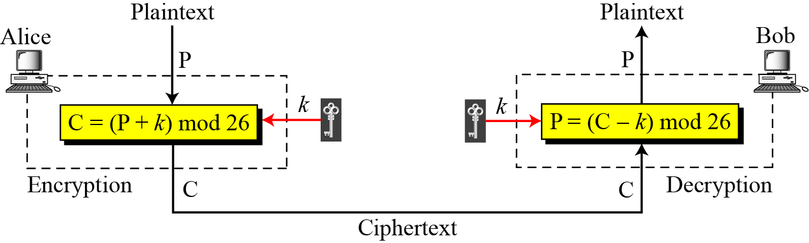
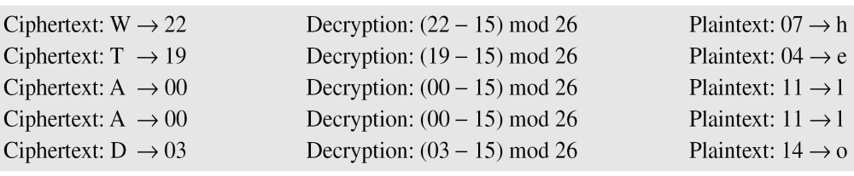
Cont . . .
Exercise: Use the additive cipher with key = 15 to decrypt the message “WTAAD”.
Solution:- We apply decryption algorithm to the plaintext character by character:
Notes:
SCA3103 - Introduction to Multimedia
Semester 2 - 02/03
Lecture 1

Slide 29
Cont . . .
Cryptanalysis of Caesar Cipher
  A brute-force cryptanalysis is easily performed: simply try all the 25 possible keys.
  The characteristics of this problem enabled us to use a brute-force
      The encryption & decryption algorithms are known.
      There are only 25 keys to try, so given ciphertext, just try all shifts of letters
      The language of plaintext is known and easily recognizable.
Example:
  Eve has intercepted the ciphertext “UVACLYFZLJBYL”.
  See on next slide how she can use a brute-force attack to break the cipher.
Notes:
SCA3103 - Introduction to Multimedia
Semester 2 - 02/03
Lecture 1

Slide 30
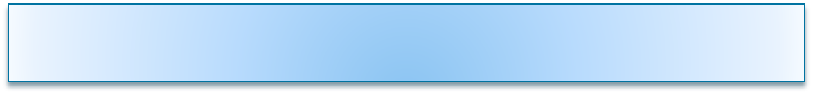
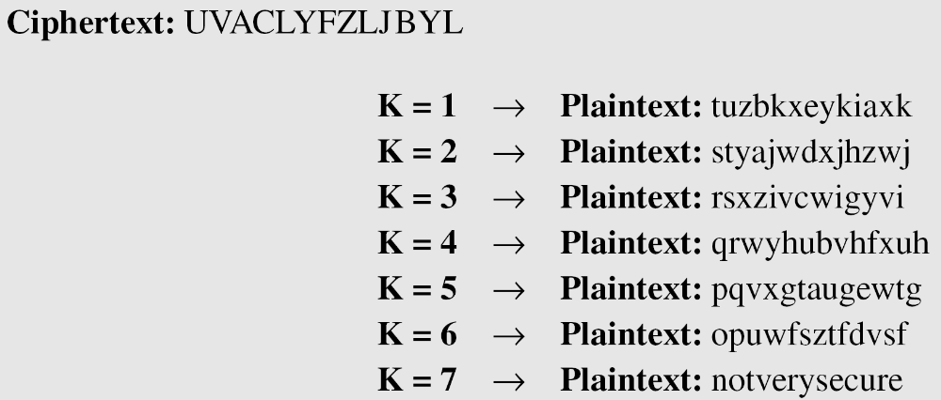
Cont . . .
Example of Brute-Force Cryptanalysis of Caesar Cipher
Exercise: break a ciphertext beloew
"GCUA VQ DTGCM"
Notes:
SCA3103 - Introduction to Multimedia
Semester 2 - 02/03
Lecture 1

Slide 31
Cont . . .
(2) Mono alphabetic Ciphers
  This is also additive cipher
  Rather than just shifting the alphabet, could shuffle (jumble) the letters arbitrarily .
  Each plaintext letter maps to a different random cipher text letter
  Arbitrary substitution dramatically increase the key space, where the translation alphabet can be any permutation of the 26 alphabetic characters.
  A permutation of a finite set of elements S is an ordered sequence of all the elements of S, with each element appearing exactly once.
  For example, if S = {a,b,c}, there are six permutations of S:
  abc, bca, cab, acb, bac, cba
Notes:
SCA3103 - Introduction to Multimedia
Semester 2 - 02/03
Lecture 1

Slide 32
Cont . . .
The “cipher” line can be any permutation of the 26 alphabetic characters, then there are 26! or greater than 4 x 10²⁶ possible keys.
Advantage: Avoid brute force attack
Problem: Nature of Language/characteristics
    Human languages are redundant. e.g. "th lrd s m shphrd nt wnt“
    Letters are not equally commonly used
    In English E is by far the most common letter followed by T, R, N, I, O, A, S and other letters like Z, J, K, Q, X are fairly rare
    Have tables of single, double & triple letter frequencies for various languages
Notes:
SCA3103 - Introduction to Multimedia
Semester 2 - 02/03
Lecture 1

Slide 33
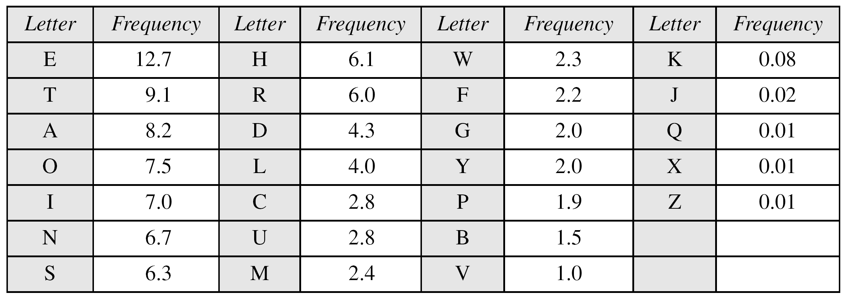
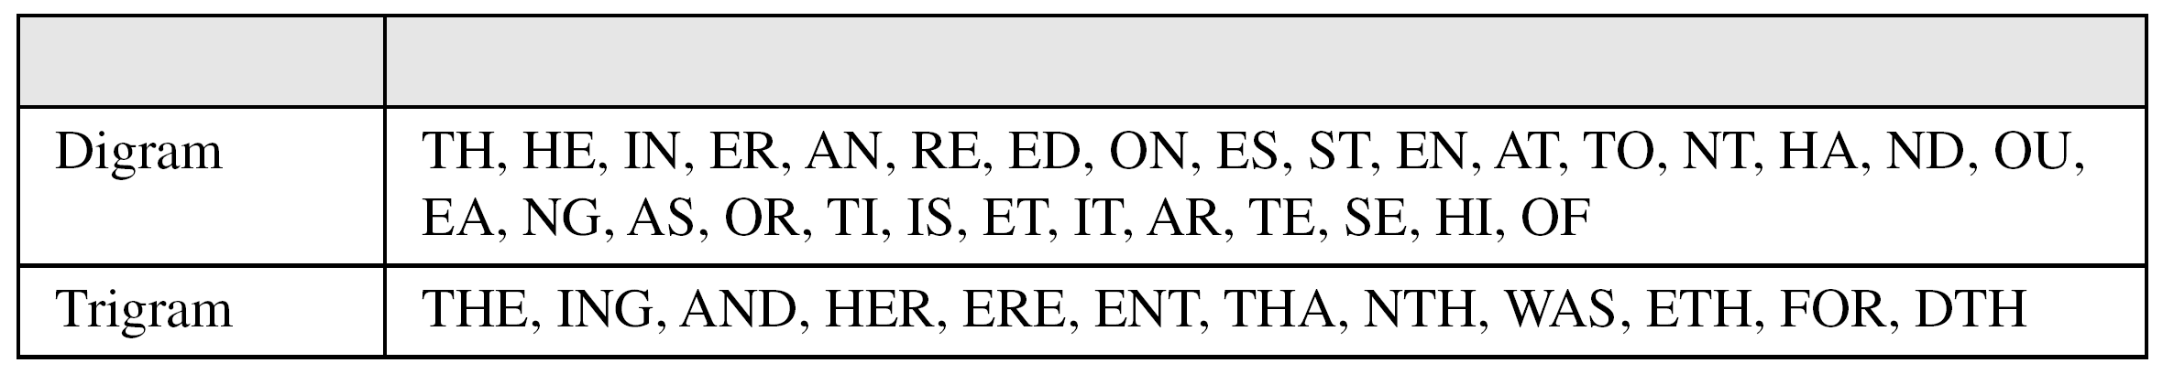
Cont . . .
Frequency of characters in English
Frequency of diagrams and trigrams
Notes:
SCA3103 - Introduction to Multimedia
Semester 2 - 02/03
Lecture 1

Slide 34
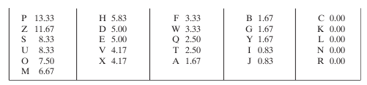
Cont . . .
Example 2: Decryption using frequency of letter
      UZQSOVUOHXMOPVGPOZPEVSGZWSZOPFPESXUDBMETSXAIZVUEPHZHMDZSHZOWSFPAPPDTSVPQUZWYMXUZUHSXEPYEPOPDZSZUFPOMBZWPFUPZHMDJUDTMOHMQ
Relative frequencies of the letters in the ciphertext (in %) are as follows
Notes:
SCA3103 - Introduction to Multimedia
Semester 2 - 02/03
Lecture 1

Slide 35
Cont . . .
Comparing this breakdown with English letter frequencies, it seems likely,
    Cipher letters P and Z are equivalents of plain letters e and t, but it is not certain.
The letters S, U, O, M, and H are all of relatively high frequency and probably correspond to plain letters from the set {a, h, i, n, o, r, s}.
The letters with the lowest frequencies (namely, A, B, G, Y, I, J) are likely included in the set {b, j, k, q, v, x, z}.
Make some tentative assignments and start to fill in the plaintext to see if it looks like a reasonable “skeleton” of a message.
Notes:
SCA3103 - Introduction to Multimedia
Semester 2 - 02/03
Lecture 1

Slide 36
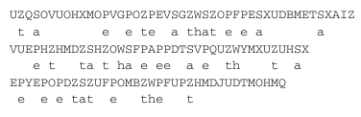

Cont . . .
Continued analysis of frequencies plus trial and error should easily yield a solution from this point.
Exercise: Eve has intercepted the following ciphertext. Using a statistical attack, show how it find the plaintext.
Notes:
SCA3103 - Introduction to Multimedia
Semester 2 - 02/03
Lecture 1

Slide 37
Cont . . .
(3) Playfair Ciphers/ Playfair Square
  Not even the large number of keys in a monoalphabetic cipher provides security
  In case of just mapping one letter always to another, the frequency distribution is just shuffled.
  One approach to improve security is to encrypt multiple letters
  Invented by Charles Wheatstone in 1854, but named after his friend Baron Playfair.
  A manual symmetric encryption technique and was the first literal digraph substitution cipher but regarded as insecure now a days.
  Treats digrams in the plaintext as single units and translates these units into ciphertext digrams.
  Based on use of 5×5 matrix of letters constructed using a keyword.
Notes:
SCA3103 - Introduction to Multimedia
Semester 2 - 02/03
Lecture 1

Slide 38
Playfair Encryption Rules
  Rule 1: Construction of 5x5 matrix with secret key
  Chose a key consisting of a string of unique characters
  Build 5x5 table beginning with key followed by remaining alphabet
      The rules for filling in 5x5 matrix are: Left to Right, Top to Bottom, first with keyword after duplicate letters have been removed, and then with the remain letters, with I/J used as a single letter.
Example:
    Using a key string “MONARCHY”
M | O | N | A | R
C | H | Y | B | D
E | F | G | I/J | K
L | P | Q | S | T
U | V | W | X | Z
Notes:
SCA3103 - Introduction to Multimedia
Semester 2 - 02/03
Lecture 1

Slide 39
Cont . . .
  Rule 2: Encryption of plaintext
Encrypt two letters of the plaintext at a time by the following rules
  Remove any punctuation and numbers in the plaintetx .
  Identify any consecutive double letters in plaintext and replace the second occurrence with X’, e.g. ‘hammer’ ----> ‘hamxer’ and “balloon” becomes “balxoxn”.
  If plaintext has an odd number of characters append ‘x’ to the end to make it even e.g. “balxoxn” --> “balxoxnx” .
  Break the plaintext into pairs of letters e.g. ‘hamxer’ --> ‘ha mx er’ and “balxoxn” --> “ba lx ox nx” .
  Locate the letters in the key square
Notes:
SCA3103 - Introduction to Multimedia
Semester 2 - 02/03
Lecture 1

Slide 40
Cont . . .
  If both letters fall in the same row, replace each with letter to their immediate right respectively (wrapping back to start from end).
  If both letters fall in the same column, replace each with the letter immediately below it (again wrapping to top from bottom).
        The “belowness” property is to be considered circular, in the sense that the topmost entry in a column is below the bottom-most entry.
  Otherwise (letters found in different rows and columns) each letter is replaced by the letter in the same row which found in the column of the other letter of the pair. The order is important (the first encrypted letter of the pair is the one that lies on the same row as the first plaintext).
Notes:
SCA3103 - Introduction to Multimedia
Semester 2 - 02/03
Lecture 1

Slide 41
Cont . . .
Example: Encrypt the plaintext “Playfair ciphers are block ciphers” using the keyword MO NA RC HY
PL AY FA IR CI PH ER SA RE BL OC KC IP HE RS
  Rule 2: “PL" encrypts as “QP"
  Rule 4: “AY" encrypts to “NB", and “FA" to “IO" or "JO“, and “IR -----> KA” and “CI -----> BE”
  Rule 3: “PH" encrypts to “VF“
  Do in the same way for the rest pair of letters
M | O | N | A | R
C | H | Y | B | D
E | F | G | I/J | K
L | P | Q | S | T
U | V | W | X | Z
Notes:
SCA3103 - Introduction to Multimedia
Semester 2 - 02/03
Lecture 1

Slide 42
Playfair Decryption Rules
  Rule 1: Construction of 5x5 matrix with secret key
  Chose a key consisting of a string of unique characters
  Build 5x5 table beginning with key followed by remaining alphabet
      The rules for filling in 5x5 matrix are: Right to Left, Bottom to Top, first with keyword after duplicate letters have been removed, and then with the remain letters, with I/J used as a single letter.
Example:
    Using a key string “MONARCHY”
Z | X | W | V | U
T | S | Q | P | L
K | I/J | G | F | E
D | B | Y | H | C
R | A | N | O | M
Notes:
SCA3103 - Introduction to Multimedia
Semester 2 - 02/03
Lecture 1

Slide 43
Cont . . .
  Rule 2: Decryption of plaintext
Encrypt two letters of the plaintext at a time by the following rules
  Break the ciphertext into pairs of letters e.g. ‘HEGHERDRY’ --> “HE GH ER DR YN” .
  Locate the letters in the key square
  If both letters fall in the same row, replace each with letter to their immediate right respectively (wrapping back to start from end).
  If both letters fall in the same column, replace each with the letter immediately below it (again wrapping to top from bottom).
  Otherwise (letters found in different rows and columns) each letter is replaced by the letter in the same row which found in the column of the other letter of the pair. The order is important
Notes:
SCA3103 - Introduction to Multimedia
Semester 2 - 02/03
Lecture 1

Slide 44
Cont . . .
Generally:
Used in WW1 and WW2
Security much improved over monoalphabetic
Since have 26 x 26 = 676 digrams
Would need a 676 entry frequency table to analyse and correspondingly more ciphertext
Was widely used for many years
e.g. by Austrialians, US & British military in WW1, WW2
It can be broken, given a few hundred letters
Since still has much of plaintext structure
Notes:
SCA3103 - Introduction to Multimedia
Semester 2 - 02/03
Lecture 1

Slide 45
Prons
Harder to crack. In this method, it breaks the usual rules of letters arranging to form a word, like ‘th’, ‘ph’,’ea’ a letters that are always together, but playfair separated them to other irrelevant-look letters that are not so easy to observe.
The simplicity and reliability of this primitive code-cracking method made it extremely popular on the battlefield.
It doesn’t contain any complex mathematic or number theory.
The frequency analysis of digraphs can be undertaken
Like most pre-modern era ciphers, the Playfair cipher can be easily cracked if there is enough text.
Nowadays, with the proper software, you could use a computer to discover the original text without knowing the cipher key. Some skilled cryptographists and puzzle experts can even break it with nothing more than pen and paper.
Cons
Notes:
SCA3103 - Introduction to Multimedia
Semester 2 - 02/03
Lecture 1

Slide 46
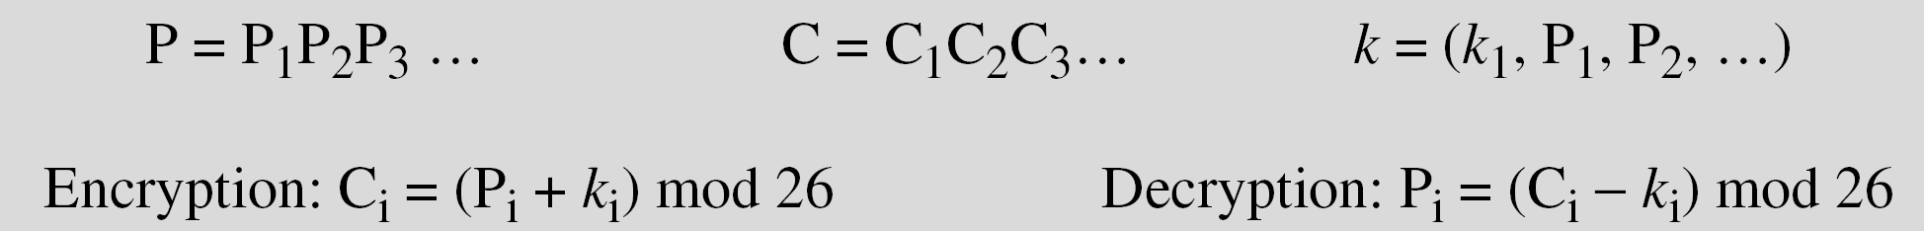
Cont . . .
(4) Polyalphabetic Ciphers
  In polyalphabetic substitution, each occurrence of a character may have a different substitute.
      The relationship between a character in the plaintext to a character in the ciphertext is one-to-many unlike mono-a alphabetic which is one-to-one.
      The same plaintext letter could be replaced by several ciphertext letters, depending on which alphabet is used.
  Gives the attacker more work, since many alphabets need to be guessed, and because the frequency distribution is more complex.
Notes:
SCA3103 - Introduction to Multimedia
Semester 2 - 02/03
Lecture 1

Slide 47
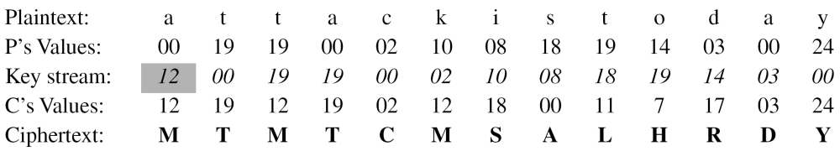
Cont . . .
All type of polyalphabetic substitution have the following features in common:
    A set of related monoalphabetic substitution rules is used.
    A key determines which particular rule is chosen for a given transformation.
Assume that Alice and Bob agreed to use an autokey cipher with initial key value k1 = 12. Now Alice wants to send Bob the message “Attack is today”. Enciphering is done character by character.
Notes:
SCA3103 - Introduction to Multimedia
Semester 2 - 02/03
Lecture 1

Slide 48
Cont . . .
(a) Vigenère Cipher
  Set of related monoalphabetic substitution rules consists of the 26 Caesar ciphers with shifts of 0 through 25.
  Each cipher is denoted by a key letter, which is the ciphertext letter that substitutes for the plaintext letter.
  Thus, a Caesar cipher with a shift of 3 is denoted by the key value
Mathematical definition
Assume a sequence of plaintext letters P = P₀,P₁,P₂,….P_{n-1} and a key consisting of the sequence of letters K = K₀,K₁,K₂,….K_{m-1}, where m < n.
The sequence of ciphertext letters C=C₀,C₁,C₂,….C_{n-1} is calculated as: C = C₀,C₁,C₂,….C_{n-1} = E(K,P) = E[(K₀,K₁,….K_{m-1}), (P₀,P₁,….P_{n-1} )] = (p₀ +k₀) mod 26, (p₁ +k₁) mod 26, . . . , (p_{m-1} +k_{m-1}) mod 26, (p_{m} +k₁) mod 26, (p_{m+1} +k₁) mod 26, . . . , (p_{2m-1} +k_{m-1}) mod 26 ……
Notes:
SCA3103 - Introduction to Multimedia
Semester 2 - 02/03
Lecture 1

Slide 49
Cont . . .
Vigenère Cipher
A general equation of the encryption process look as follow:
  C_{i} = (P_{i} + K_{i mod m}) mod 26
  While decryption
  P_{i} = (C_{i} - K_{i mod m}) mod 26
To encrypt message, a key is needed that is as long as the message and usually the key is a repeating keyword.
Example:
  plaintext: we are discovered save yourself
  key: deceptive
  ciphertext: ZICVTWQNGRZGVTWAVZHCQYGLMGJ
Notes:
SCA3103 - Introduction to Multimedia
Semester 2 - 02/03
Lecture 1

Slide 50
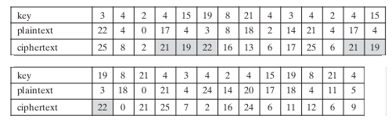
Cont . . .
Expressed numerically, we have the following result.
Security of vigenère cipher
  The letter frequency information is obscured, since there are multiple ciphertext letters for each plaintext letter.
  However, not all knowledge of the plaintext structure is lost
Problem in vigenère cipher
  If two identical sequences of plaintext letters occur at a distance that is an integer multiple of the keyword length, they will generate identical ciphertext sequences.
Notes:
SCA3103 - Introduction to Multimedia
Semester 2 - 02/03
Lecture 1

Slide 51
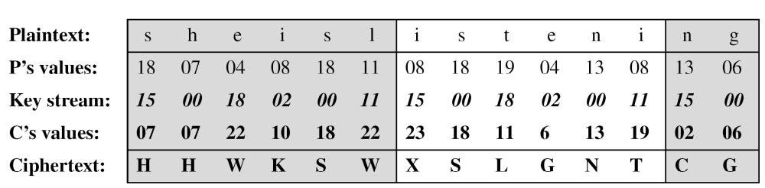
Cont . . .
Example:
    We can encrypt the message “She is listening” using the 6-character keyword “PASCAL”.
Let us see how we can encrypt the message “She is listening” using the 6-character keyword “PASCAL”. The initial key stream is (15, 0, 18, 2, 0, 11). The key stream is the repetition of this initial key stream (as many times as needed).
Notes:
SCA3103 - Introduction to Multimedia
Semester 2 - 02/03
Lecture 1

Slide 52
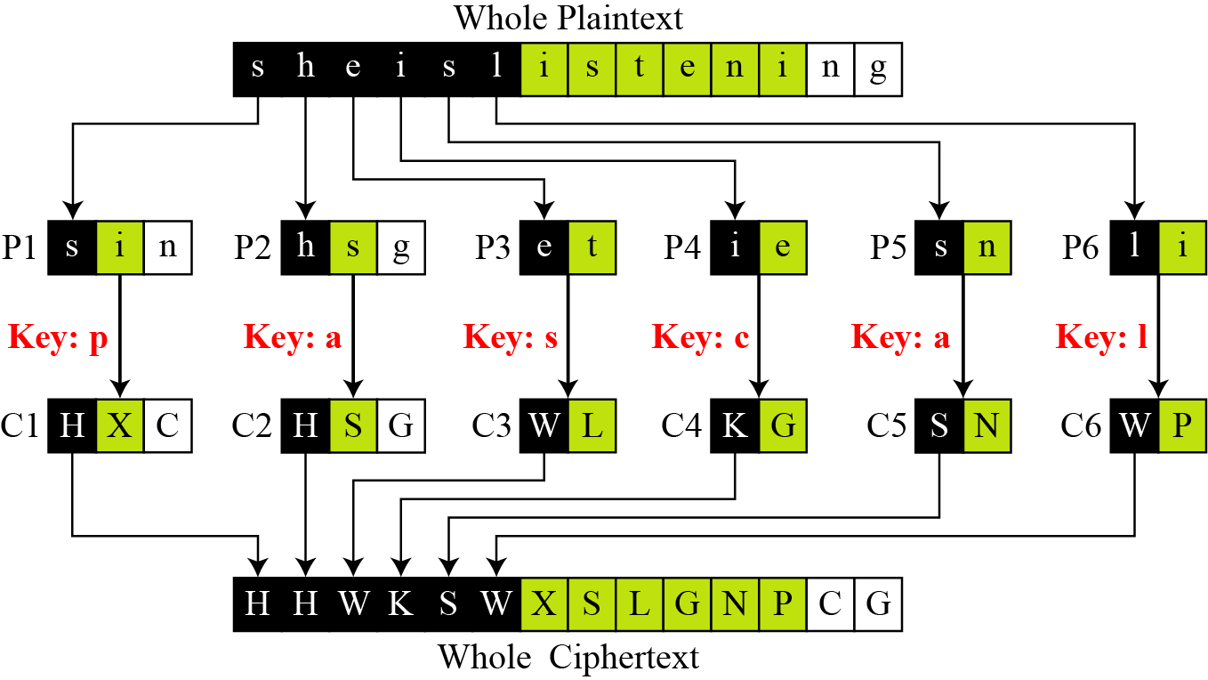
Cont . . .
Vigenere cipher can be seen as combinations of m additive ciphers
Notes:
SCA3103 - Introduction to Multimedia
Semester 2 - 02/03
Lecture 1

Slide 53
Cont . . .
(b) Vernam Cipher
To overcome the draw back of vigenère cipher, this technique choose a keyword that is as long as the plaintext and has no statistical relationship to it.
Works on binary data (bits) rather than letters
C_{i} = P_{i} K_{i}
where
P_{i} = i^{th} binary digit of plaintext
K_{i} = i^{th} binary digit of key
C_{i} = i^{th} binary digit of ciphertext
= exclusive-or (XOR) operation
The ciphertext is generated by performing the bitwise XOR of the plain-text and the key.
+
+
Notes:
SCA3103 - Introduction to Multimedia
Semester 2 - 02/03
Lecture 1

Slide 54
Cont . . .
(c) One-Time Pad
Proposed an improvement to the Vernam cipher that yields the ultimate in security.
Features
    Key need not to be repeated
    Key is to be used to encrypt and decrypt a single message, then discarded
    Each new message requires a new key of the same length as the new message
    It produces random cipher-text output that bears no statistical relationship to the plaintext.
    Ciphertext contains no information whatsoever about the plaintext
Notes:
SCA3103 - Introduction to Multimedia
Semester 2 - 02/03
Lecture 1

Slide 55
Cont . . .
Example:
Ciphertext: ANKYODKYUREPFJBYOJDSPLREYIUNOFDOIUERFPLUYTS
  Key: pxlmvmsydofuyrvzwc tnlebnecvgdupahfzzlmnyih
  Plaintext: mr mustard with the candlestick in the hall
  Key: mfugpmiydgaxgoufhklllmhsqdqogtewbqfgyovuhwt
  Plaintext: miss scarlet with the knife in the library
Difficulties
  There is the practical problem of making large quantities of random keys
  Even more daunting is the problem of key distribution and protection
Notes:
SCA3103 - Introduction to Multimedia
Semester 2 - 02/03
Lecture 1

Slide 56
5. Transposition Techniques
A kind of mapping is achieved by performing some sort of permutation on the plaintext letters.
Simple transposition ciphers, which were used in the past, are keyless.
(1) Rail fence technique
  The plaintext is written down as a sequence of diagonals and then read off as a sequence of rows.
  The ciphertext is created reading the pattern row by row. For example, to send the message “Meet me at the park” to Bob, Alice writes
  E.g. to encipher the message “meet me after the toga party” with a rail fence of depth 2, we write it as follow:
  The encrypted message is: MEMATRHTGPRYETEFETEOAAT

Slide 57
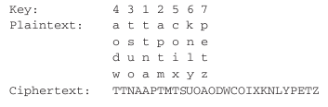
Cont . . .
(2) Rectangular technique
  Write the message in a rectangle, row by row, and read the message off, column by column, but permute the order of the columns.
  The order of the columns then becomes the key to the algorithm.
  For example
  The key is 4312567. To encrypt, start with the column that is labeled 1, in this case column 3. Write down all the letters in that column. Proceed to column 4, which is labeled 2, then column 2, then column 1, then columns 5, 6, and 7.

Slide 58
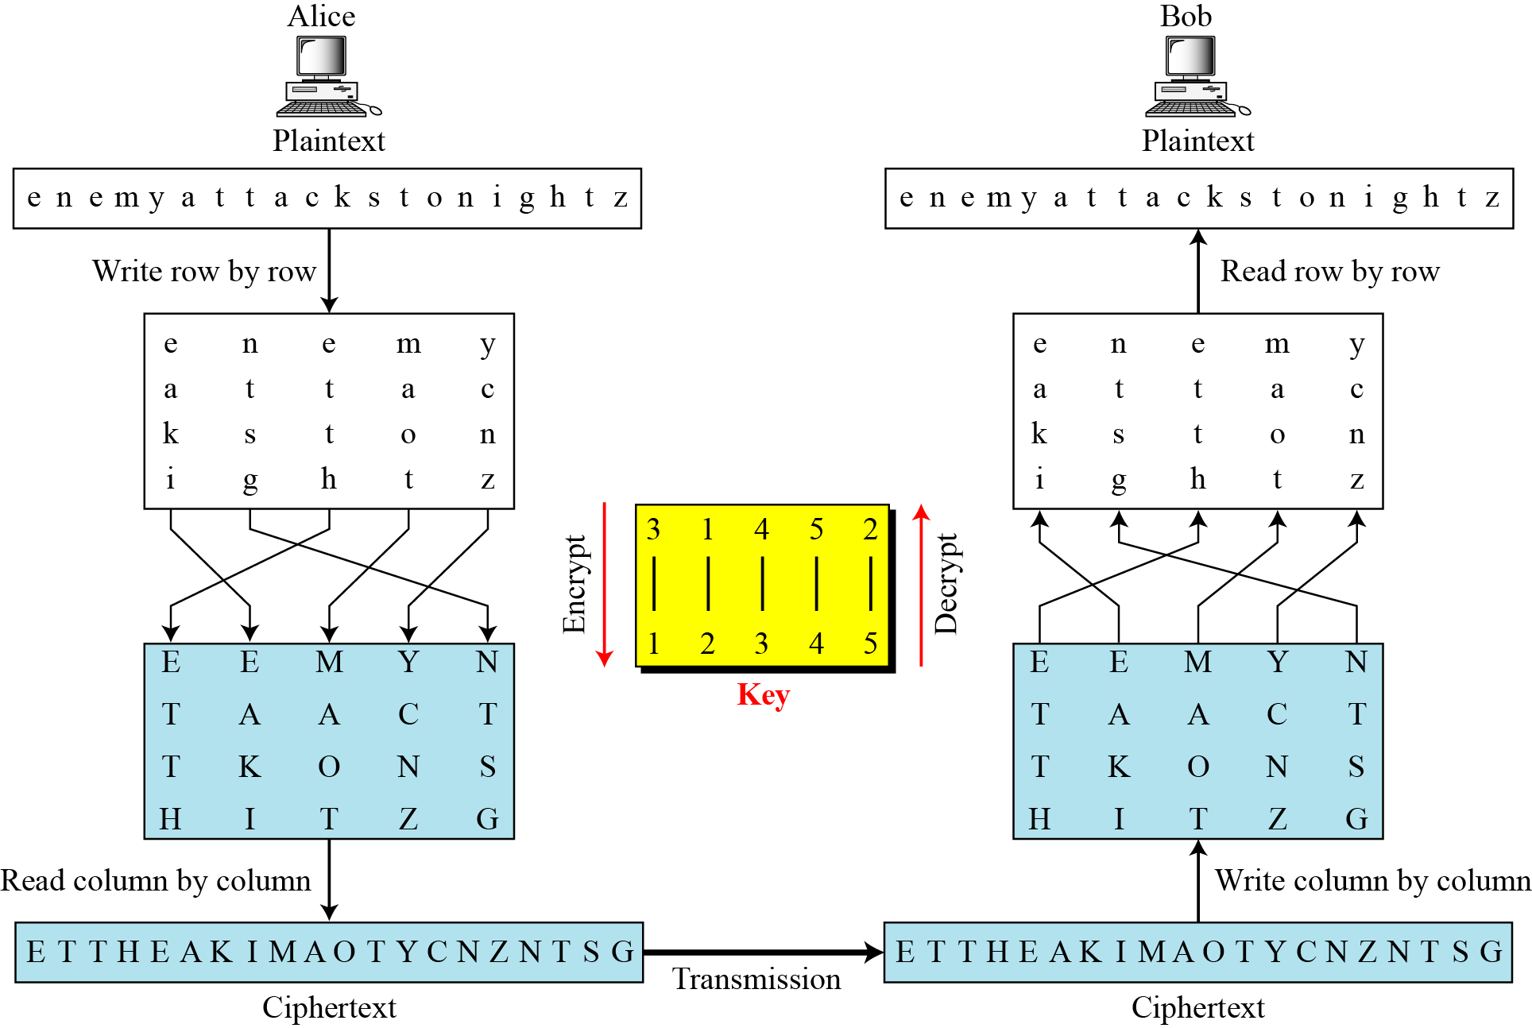
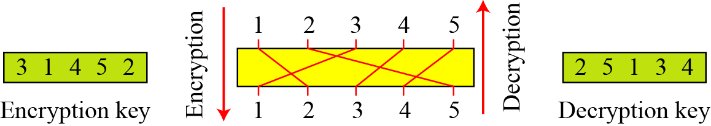
Combining encryption and decryption two Approaches
Encryption/decryption keys in transpositional ciphers

Slide 59
Cont . . .
(3) Digram/trigram transposition techniques
  A pure transposition cipher is easily recognized because it has the same letter frequencies as the original plaintext
  Columnar transposition just shown before, cryptanalysis is fairly straightforward and involves laying out the ciphertext in a matrix and playing around with column positions.
  Digram and trigram frequency tables can be useful
  The transposition cipher can be made significantly more secure by performing more than one stage of transposition.
  The result is a more complex permutation that is not easily reconstructed

Slide 60
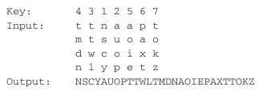



Cont . . .
Example:
With 28 letters in the message, the original sequence of letters is
After the first transposition, we have which has a somewhat regular structure
After the second transposition we have, much less structured permutation and is much more difficult to cryptanalyze

Slide 61
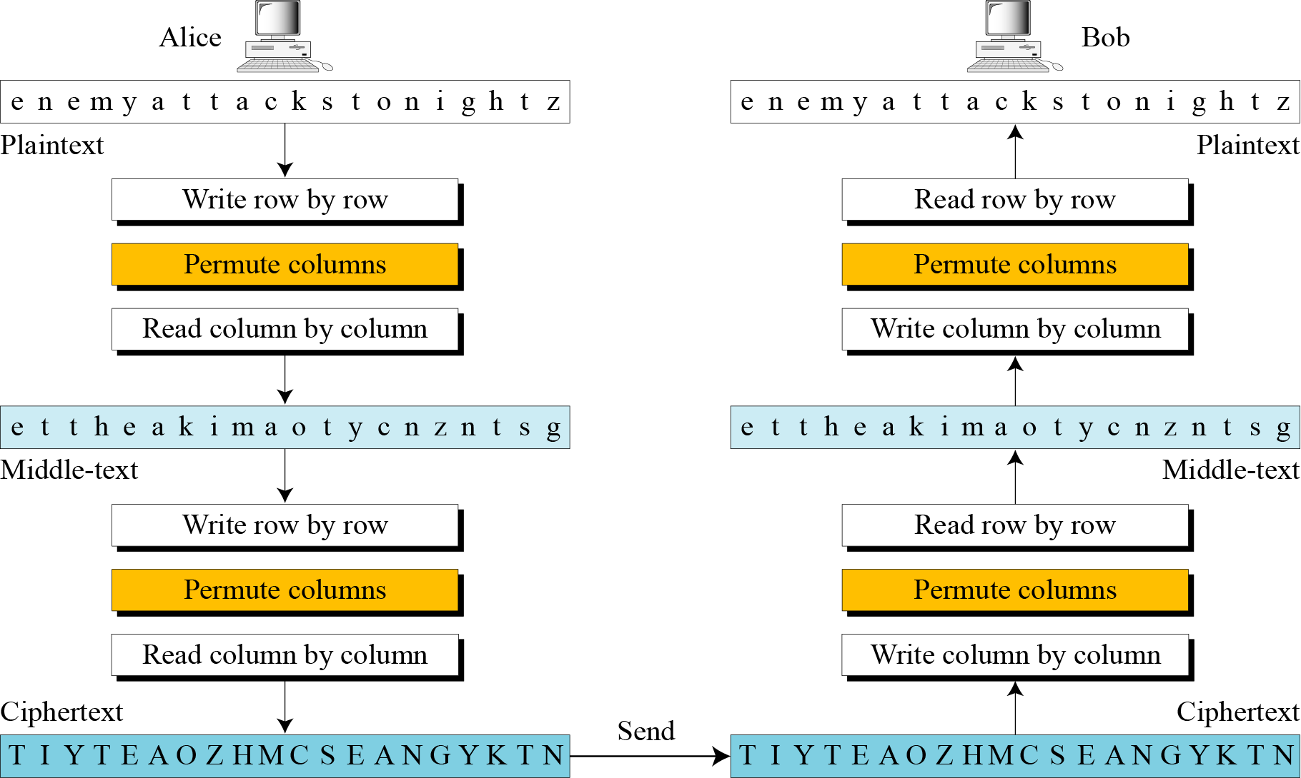
Continued
Double transposition cipher

Slide 62
6. Rotor Machine Techniques
A simple substitution cipher
The machine consists of a set of independently rotating cylinders through which electrical pulses can flow.
Each cylinder has 26 input pins and 26 output pins
Internal wiring connects each input pin to a unique output pin.
For simplicity, only three of the internal connections in each cylinder are shown.
Single cylinder Machine
  Input key depressed ----- > the cylinder rotates one position ----- > the internal connections are shifted accordingly. Thus, different monoalphabetic substitution cipher is defined.
  After 26 letters of plaintext, the cylinder would be back to the initial position. Thus, we have a poly-alphabetic substitution a period of 26.

Slide 63
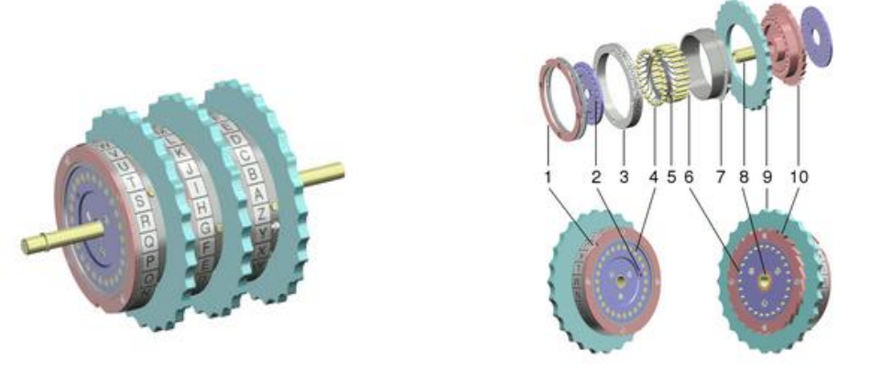
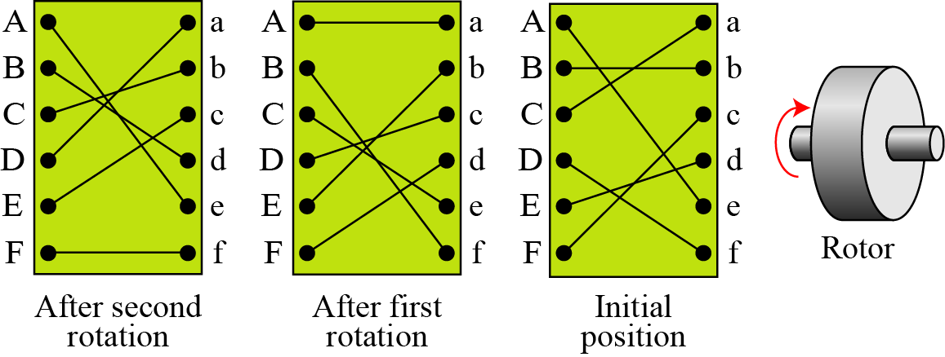
Cont . . .

Slide 64
Cont . . .
Multiple cylinder Machine
    Output pins of one cylinder are connected to input pins of the next.
Example: Three-cylinder machine
  The cylinders, closest to the operator input rotates one pin position with each keystroke.
  For every complete rotation of the inner cylinder, the middle cylinder rotates one pin position.
  Finally, for every complete rotation of the middle cylinder, the outer cylinder rotates one pin position.
  The result is that there are 26 X 26 X 26 different substitution alphabets used before the system repeats.
  Left half of figure shows position of input from operator to the first pin (plaintext letter a) is routed through the three cylinders to appear at the output of the second pin (ciphertext letter B).

Slide 65
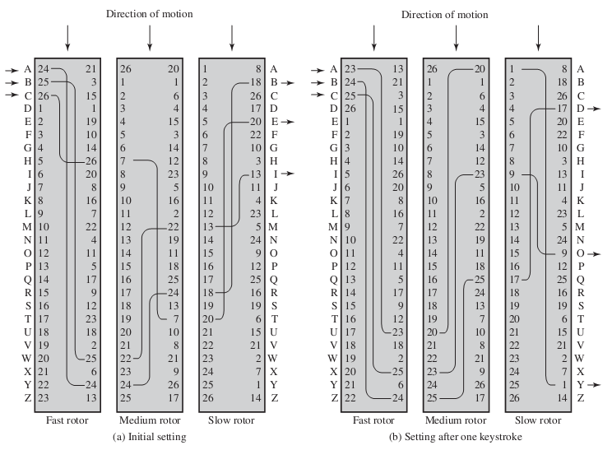
Cont . . .

Slide 66
7. Steganography Techniques
Unlike cryptography methods which render the message unintelligible (meaningless) to outsiders, this method conceal/hide the existence of the message.
An alternative to encryption
A simple form of steganography, but time-consumer to construct, is one in which an arrangement of words/letters within an apparently innocuous text spells out the real message.
    E.g., the sequence of first letters of each word of the overall message spells out the hidden message.
Character marking:
  Selected letters of printed/typewritten text are overwritten in pencil.
  The marks are ordinarily not visible unless the paper is held at an angle to bright light.

Slide 67
Cont . . .
Invisible ink:
  A number of substances can be used for writing but leave no visible trace until heat or some chemical is applied to the paper
Pin punctures:
  Small pin punctures on selected letters are ordinarily not visible unless the paper is held up in front of a light.
Typewriter correction ribbon:
  Used between lines typed with a black ribbon, the results of typing with the correction tape are visible only under a strong light
Example:
    Kodak Photo CD

Slide 68
Cont . . .
Drawback:
  Requires a lot of overhead to hide a relatively few bits of information
Advantages:
  Can be employed by parties who have something to lose should the fact of their secret communication (not necessarily the content) be discovered.
  Encryption flags traffic as important or secret or may identify the sender or receiver as someone with something to hide.

Slide 69
STREAM CIPHERS OR BLOCK CIPHERS?????
The literature divides the symmetric ciphers into two broad categories: stream ciphers and block ciphers.
Although the definitions are normally applied to modern ciphers, this categorization also applies to traditional ciphers.
Example of Stream Ciphers
  Ceaser cipher (i.e. additive ciphers)
  The monoalphabetic substitution ciphers
  Vigenere ciphers
Example of Block Ciphers
  Playfair ciphers
  Hill ciphers

Slide 70
MONO-ALPAHBETIC VS. POLY-ALPHABETIC
We can establish a criterion to divide stream ciphers based on their key streams.
We can say that a stream cipher is a monoalphabetic cipher if the value of k_{i} does not depend on the position of the plaintext character in the plaintext stream; otherwise, the cipher is polyalphabetic.
Additive ceaser ciphers and Monoalphabetic substitution ciphers are monoalphabetic because k_{i} does not depend on the position of the corresponding character in the plaintext stream; where Vigenere ciphers are polyalphabetic ciphers because k_{i} definitely depends on the position of the plaintext character.
From the definition of the block cipher, it is clear that every block cipher is a polyalphabetic cipher because each character in a ciphertext block depends on all characters in the plaintext block.

Slide 71
THE END
???

Slide 72
Reading Assignment
The Hill Algorithms/Techniques

Slide 73
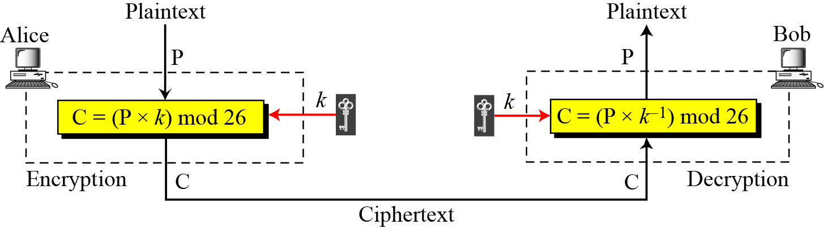

Multiplicative Ciphers
Note
In a multiplicative cipher, the plaintext and ciphertext are integers in Z₂₆; the key is an integer in Z26*.

Slide 74
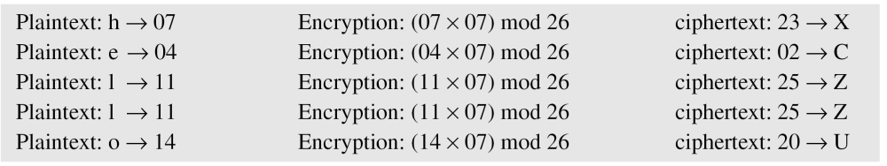
Continued
Example 3.7
What is the key domain for any multiplicative cipher?
Solution
The key needs to be in Z₂₆*. This set has only 12 members: 1, 3, 5, 7, 9, 11, 15, 17, 19, 21, 23, 25.
Example 3.8
We use a multiplicative cipher to encrypt the message “hello” with a key of 7. The ciphertext is “XCZZU”.

Slide 75
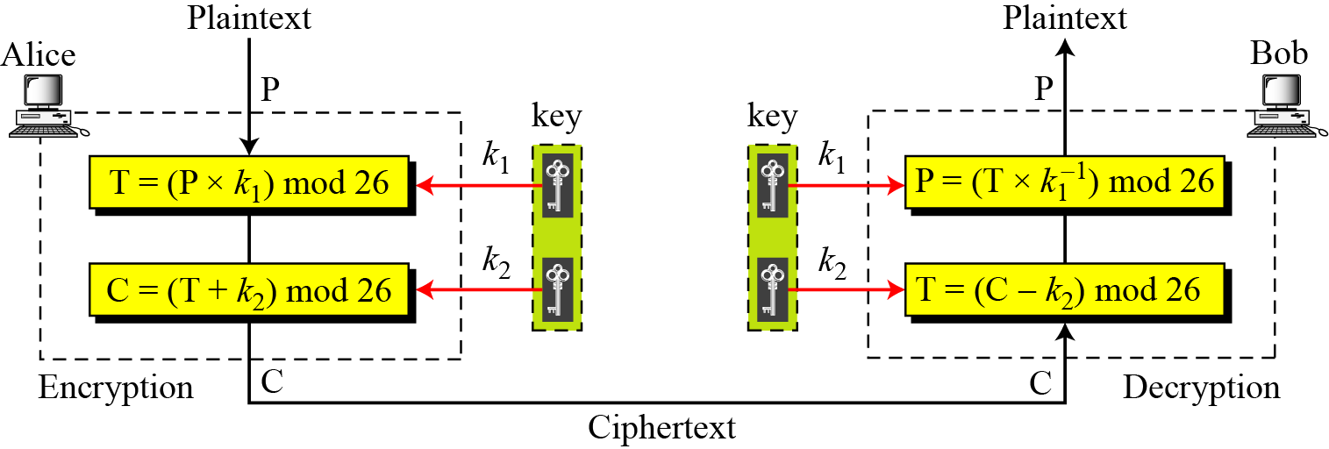
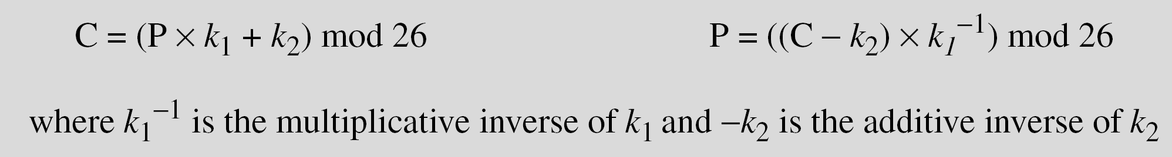
Affine Ciphers

Slide 76
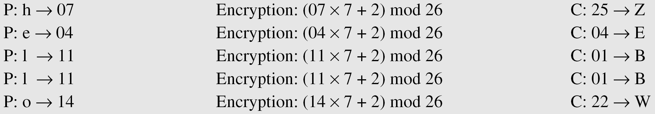
Continued
Example 3.09
The affine cipher uses a pair of keys in which the first key is from Z₂₆* and the second is from Z₂₆.
The size of the key domain is 26 × 12 = 312.
Example 3.10
Use an affine cipher to encrypt the message “hello” with the key pair (7, 2).

Slide 77
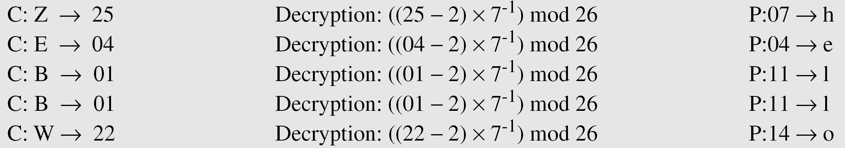
Continued
Example 3.11
Use the affine cipher to decrypt the message “ZEBBW” with the key pair (7, 2) in modulus 26.
Solution
Example 3.12
The additive cipher is a special case of an affine cipher in which
k₁ = 1. The multiplicative cipher is a special case of affine cipher in which k₂ = 0.

Slide 78
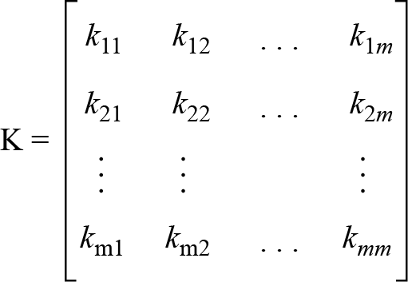
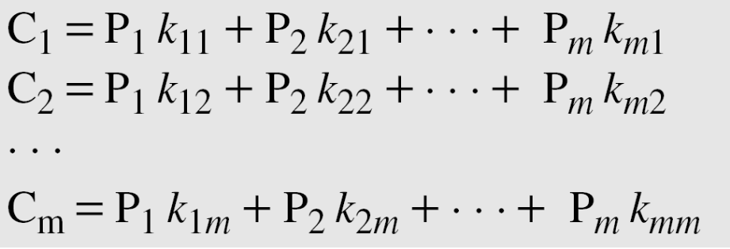
Hill Cipher
Key in the Hill cipher
Note
The key matrix in the Hill cipher needs to have a multiplicative inverse.

Slide 79
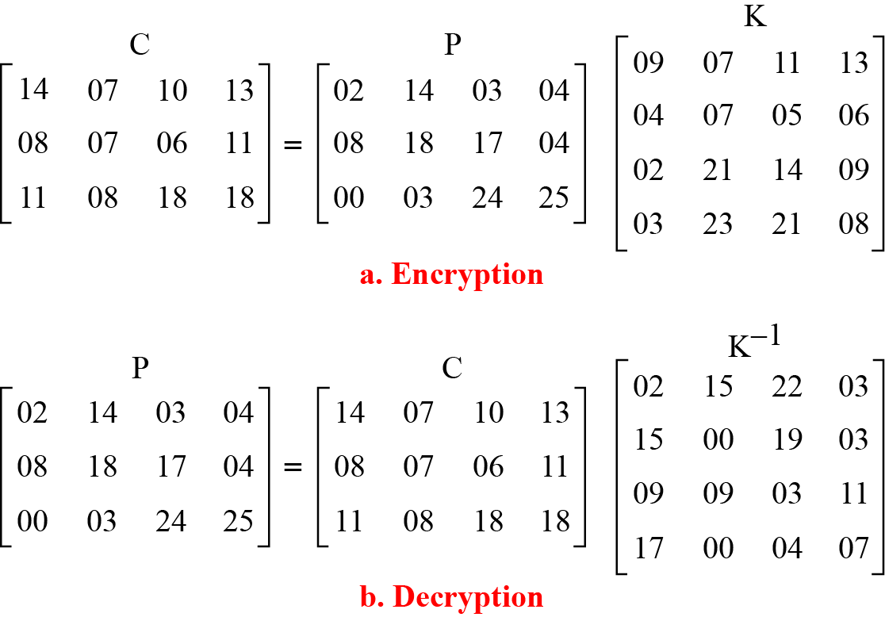
Continued
Example 3.20
For example, the plaintext “code is ready” can make a 3 × 4 matrix when adding extra bogus character “z” to the last block and removing the spaces. The ciphertext is “OHKNIHGKLISS”.

Slide 80
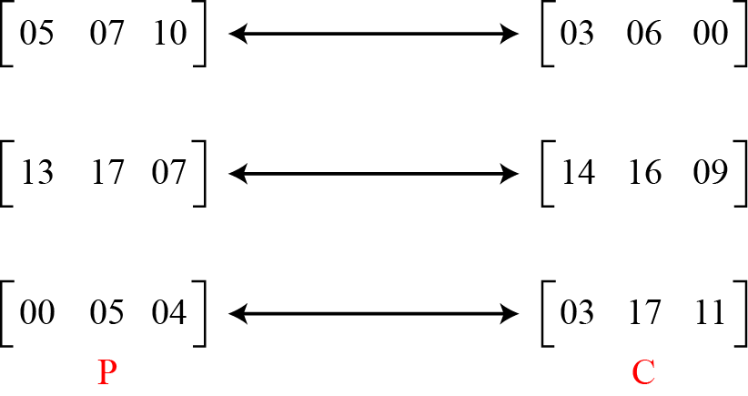
Continued
Example 3.21
Assume that Eve knows that m = 3. She has intercepted three plaintext/ciphertext pair blocks (not necessarily from the same message) as shown in Figure 3.17.

Slide 81
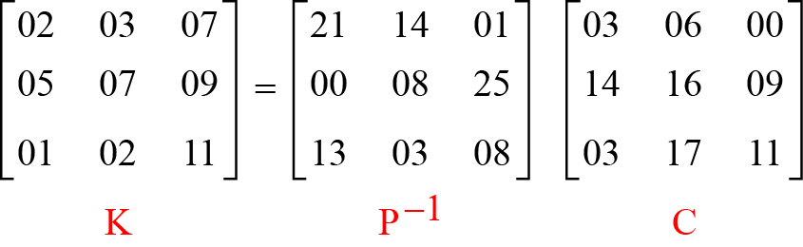
Continued
Example 3.21
(Continued)
She makes matrices P and C from these pairs. Because P is invertible, she inverts the P matrix and multiplies it by C to get the K matrix as shown in Figure 3.18.
Now she has the key and can break any ciphertext encrypted with that key.

Slide 82
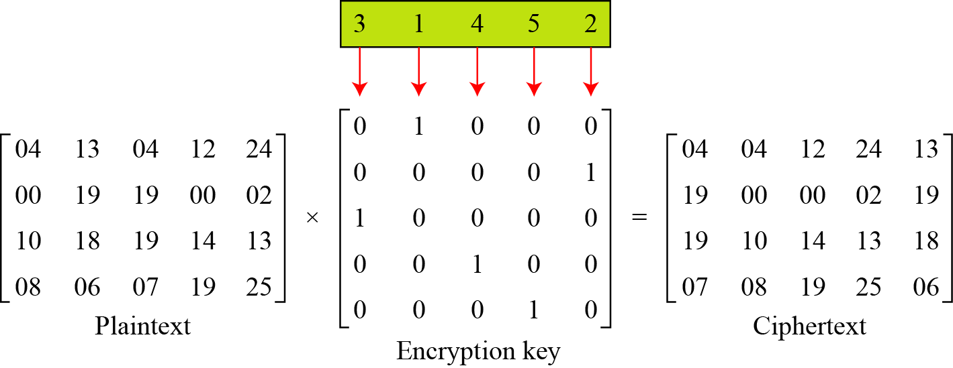
Transposition using Matrix
We can use matrices to show the encryption/decryption process for a transposition cipher.
The below table shows the encryption process. Multiplying the 4 × 5 plaintext matrix by the 5 × 5 encryption key gives the 4 × 5 ciphertext matrix.
Representation of the key as a matrix in the transposition cipher

Slide 83
What makes a "Good" cipher?
In 1949 Shannon proposed the below characteristics of a good cipher:
    The amount of required secrecy should determine the amount of encrypting/decrypting work.
    The choice of keys and the enciphering algorithm should be free from complexity.
    The implementation of the process should be as simple as possible.
    Errors in ciphering should not propagate, corrupting other message parts.
    The size of the ciphertext should be no larger than its corresponding plaintext.
Today’s priorities:
    The encryption/decryption algorithm must be proven to be mathematically sound.’
    The algorithm must have been analyzed by experts for its vulnerability
    The algorithm must have stood the “test of time”.
    Time to encode/decode must still be acceptable

